Slide 1
INFDEV036A - Algorithms Lesson Unit 2
G. Costantini, F. Di Giacomo
costg@hr.nl, giacf@hr.nl – Office H4.206

Slide 2
Today
Why is my code slow?
Empirical and complexity analysis
How do I order my data?
Sorting algorithms
How do I structure my data?
Linear, tabular, recursive data structures
How do I represent relationship networks?
Graphs

Slide 3
Sorting algorithms
Insertion sort, Merge sort
http://www.youtube.com/watch?v=INHF_5RIxTE
https://caspervonb.github.io/toneofsorting/

Slide 4
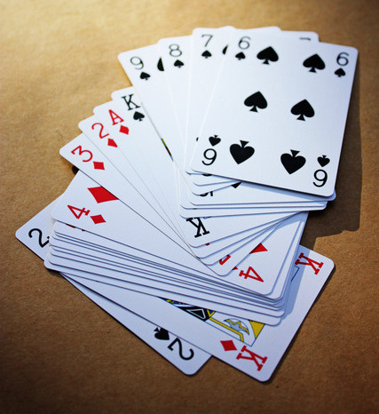

Sorting algorithms
Algorithms that put elements of a sequence in a certain order (numerical/lexicographical)
fundamental problem in computer science
as a standalone algorithm (i.e., producing human readable output)
as part of more complex algorithms which require sorted data (i.e., binary search!)
usually, data is considered to be stored in an array

Slide 5
Sorting algorithms
Popular sorting algorithms
Simple sorts
Insertion sort, selection sort
Efficient sorts
Merge sort, Quick sort, Heap sort
Bubble sort and variants
Bubble sort, Shell sort, Comb sort
Distribution sort
Counting sort, Bucket sort, Radix sort
In practice, a few algorithms predominate
Notes:
In practical implementations a few algorithms predominate. Insertion sort is widely used for small data sets, while for large data sets an asymptotically efficient sort is used, primarily heap sort, merge sort, or quicksort (the overhead of these algorithms becomes significant on smaller data; the algorithms often perform poorly on already sorted data or almost sorted data; they may also be unstable).

Slide 6
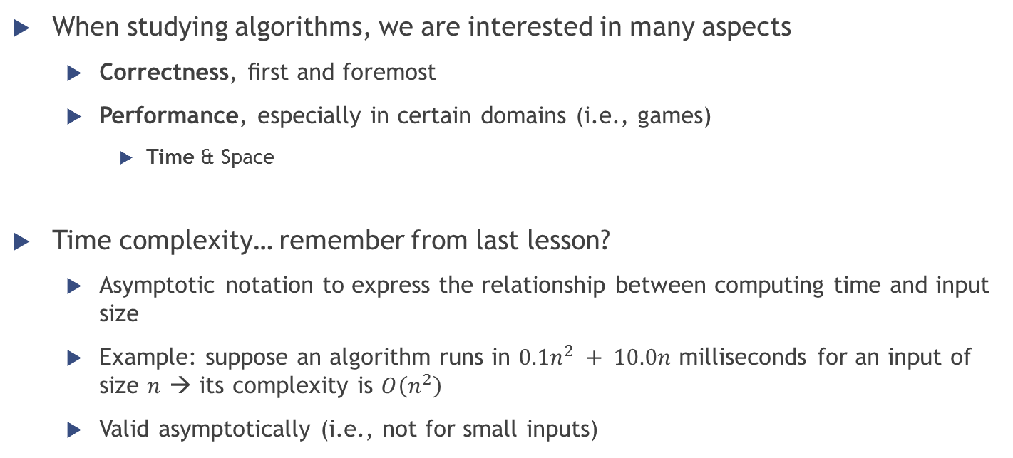
Sorting algorithms
When studying algorithms, we are interested in many aspects
Correctness, ﬁrst and foremost
Performance, especially in certain domains (i.e., games)
Time & Space
Time complexity… remember from last lesson?
Asymptotic notation to express the relationship between computing time and input size
Example: suppose an algorithm runs in $0.1n^{2} + 10.0n$ milliseconds for an input of size $n$ → its complexity is $O\left(n^{2}\right)$
Valid asymptotically (i.e., not for small inputs)

Slide 7
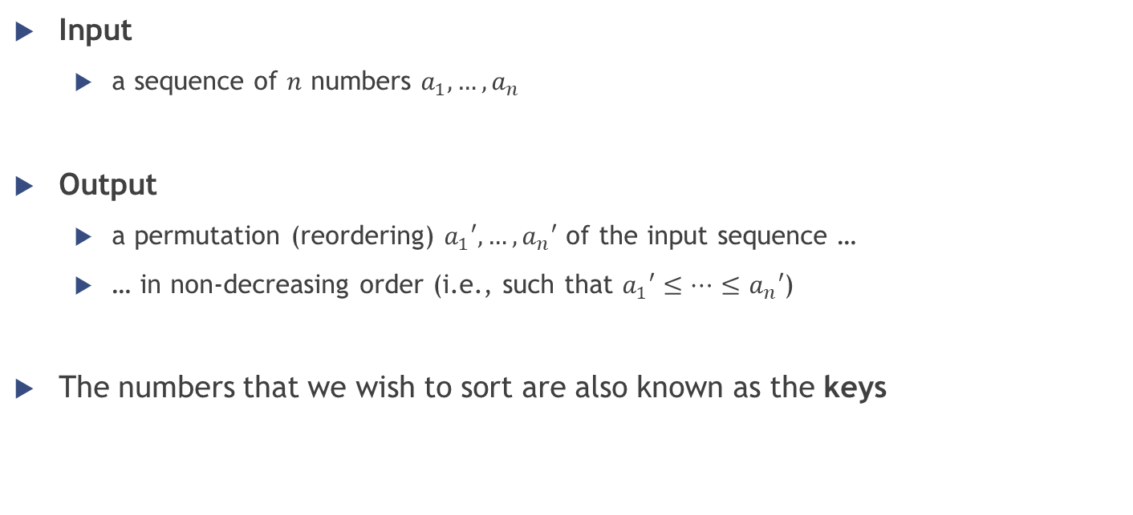
Sorting algorithms
Input
a sequence of $n$ numbers $a_{1},…,a_{n}$
Output
a permutation (reordering) $a_{1}′,…,a_{n}′$ of the input sequence …
… in non-decreasing order (i.e., such that $a_{1}′≤…≤a_{n}′$)
The numbers that we wish to sort are also known as the keys

Slide 8
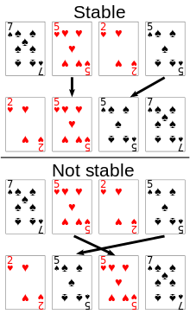
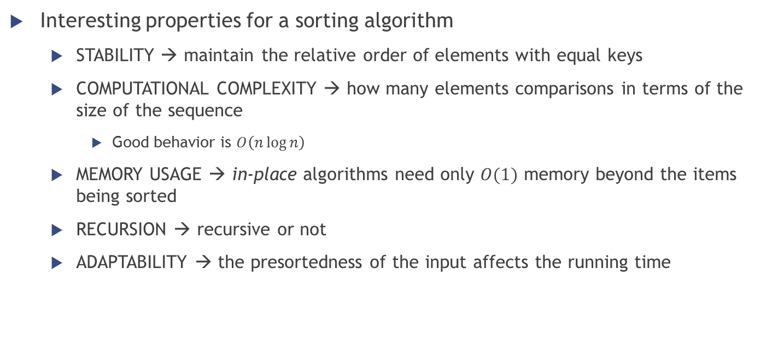
Sorting algorithms Properties
Interesting properties for a sorting algorithm
STABILITY → maintain the relative order of elements with equal keys
COMPUTATIONAL COMPLEXITY → how many elements comparisons in terms of the size of the sequence
Good behavior is $O\left(n\log{n}\right)$
MEMORY USAGE → in-place algorithms need only $O(1)$ memory beyond the items being sorted
RECURSION → recursive or not
ADAPTABILITY → the presortedness of the input affects the running time

Slide 9
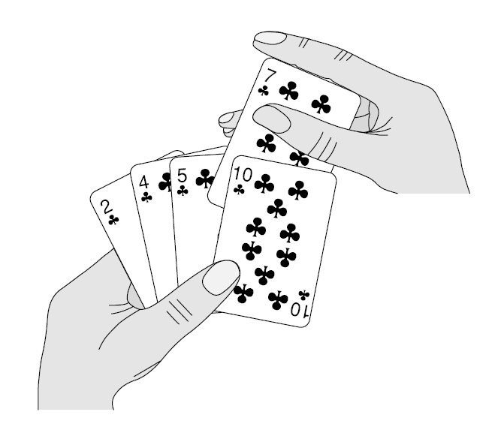

Insertion sort

Slide 10
Insertion sort
Basic idea
When people manually sort something (for example, a deck of playing cards), most use a method that is similar to insertion sort
Put one element at a time in its right position in the sorted sub-array
The final sorted array (or list) is built one item at a time

Slide 11
Insertion sort
Graphical example

Slide 12
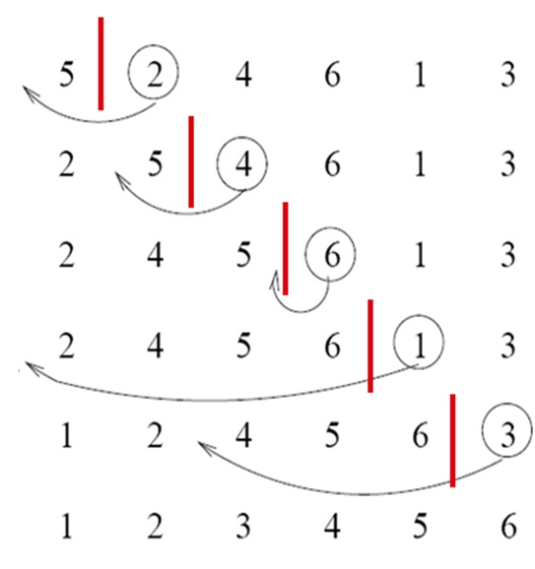
Insertion sort
Iterative algorithm
At each iteration one input element is consumed, growing a sorted output sequence
Iteration
remove one element from the input data
find the location it belongs within the sorted sequence
insert it there
Repeat until no input elements remain

Slide 13
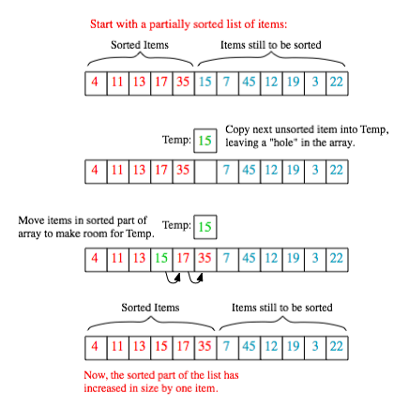
Insertion sort
Sorting is typically done in-place
For each unsorted item
shift all the larger values up to make a space
then insert it into the correct position
Notes:
at each array-position, check the value there against the largest value in the sorted list (i.e., next to it, in the previous array-position checked)
if larger, it leaves the element in place and moves to the next
if smaller, it finds the correct position within the sorted list, shifts all the larger values up to make a space, and inserts into that correct position

Slide 14
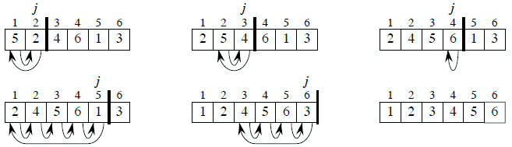
Insertion sort
Pseudo-code of the algorithm (supposing the origin of the array is 1)
FOR j = 2 to length(A)
key = A[j]
% put A[j] into the sorted sequence A[1..j-1]
i = j - 1
WHILE i > 0 and A[i] > key
A[i+1] = A[i]
i = i – 1
A[i+1] = key

Slide 15

Insertion sort
FOR j = 2 to length(A)
key = A[j]
% put A[j] into the sorted sequence A[1..j-1]
i = j - 1
WHILE i > 0 and A[i] > key
A[i+1] = A[i]
i = i – 1
A[i+1] = key
First iteration trace
j = 2
key = A[2] = 2
i = 1
i > 0 && A[i] > 2 ? YES
A[2] = A[1] $→$ A[2] = 5
i = i – 1 = 0
i > 0 && A[i] > 2 ? NO because i = 0
A[i+1] = 2 $→$ A[1] = 2

Slide 16

Insertion sort
FOR j = 2 to length(A)
key = A[j]
% put A[j] into the sorted sequence A[1..j-1]
i = j - 1
WHILE i > 0 and A[i] > key
A[i+1] = A[i]
i = i – 1
A[i+1] = key
Second iteration trace
j = 3
key = A[3] = 4
i = 2
i > 0 && A[i] > 4 ? YES
A[3] = A[2] $→$ A[3] = 5
i = i – 1 = 1
i > 0 && A[i] > 4 ? NO because 2 > 4 is false
A[i+1] = 4 $→$ A[2] = 4

Slide 17

Insertion sort
FOR j = 2 to length(A)
key = A[j]
% put A[j] into the sorted sequence A[1..j-1]
i = j - 1
WHILE i > 0 and A[i] > key
A[i+1] = A[i]
i = i – 1
A[i+1] = key
Third iteration trace
j = 4
key = A[4] = 6
i = 3
i > 0 && A[i] > 6 ? NO because 5 > 6 is false
A[i+1] = 6 $→$ A[4] = 6
… and so on …

Slide 18


Insertion sort
In each iteration the first remaining entry of the input is removed, and inserted into the result at the correct position, thus extending the result

Slide 19
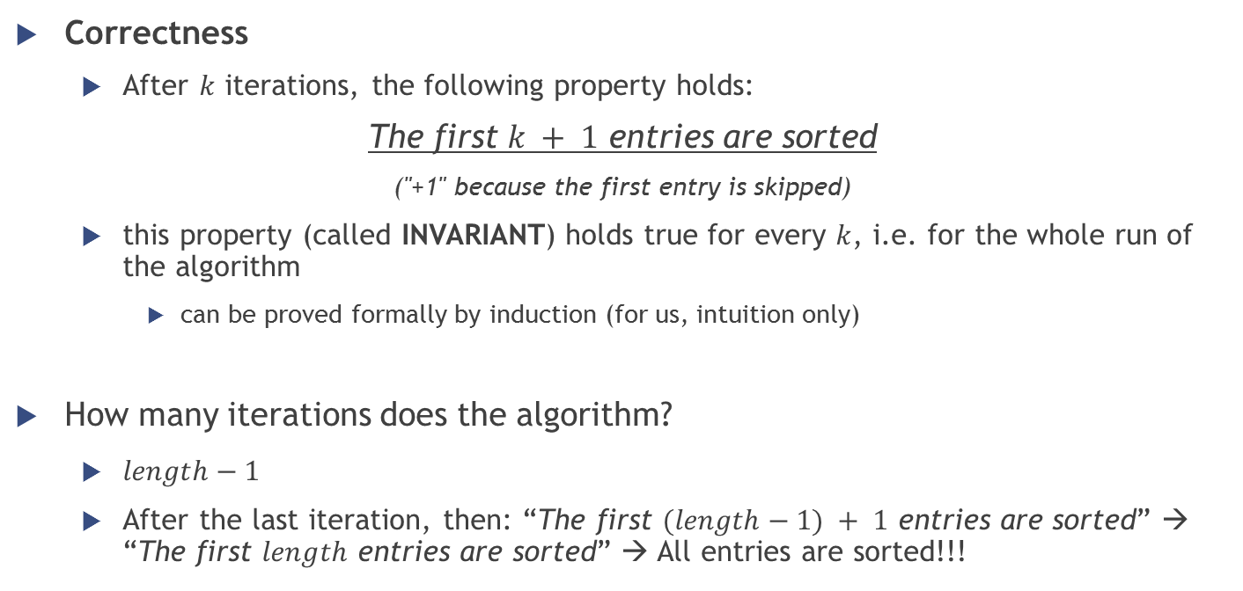
Insertion sort
Correctness
After $k$ iterations, the following property holds:
The first $k + 1$ entries are sorted
("+1" because the first entry is skipped)
this property (called INVARIANT) holds true for every $k$, i.e. for the whole run of the algorithm
can be proved formally by induction (for us, intuition only)
How many iterations does the algorithm?
$length−1$
After the last iteration, then: “The first $(length−1) + 1$ entries are sorted” → “The first $length$ entries are sorted” → All entries are sorted!!!

Slide 20
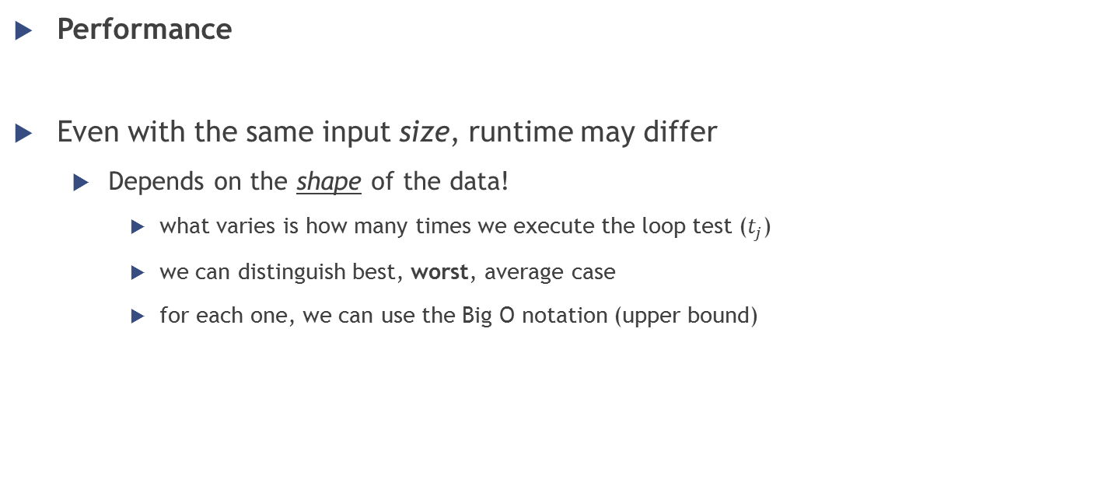
Insertion sort
Performance
Even with the same input size, runtime may differ
Depends on the shape of the data!
what varies is how many times we execute the loop test ($t_{j}$)
we can distinguish best, worst, average case
for each one, we can use the Big O notation (upper bound)

Slide 21
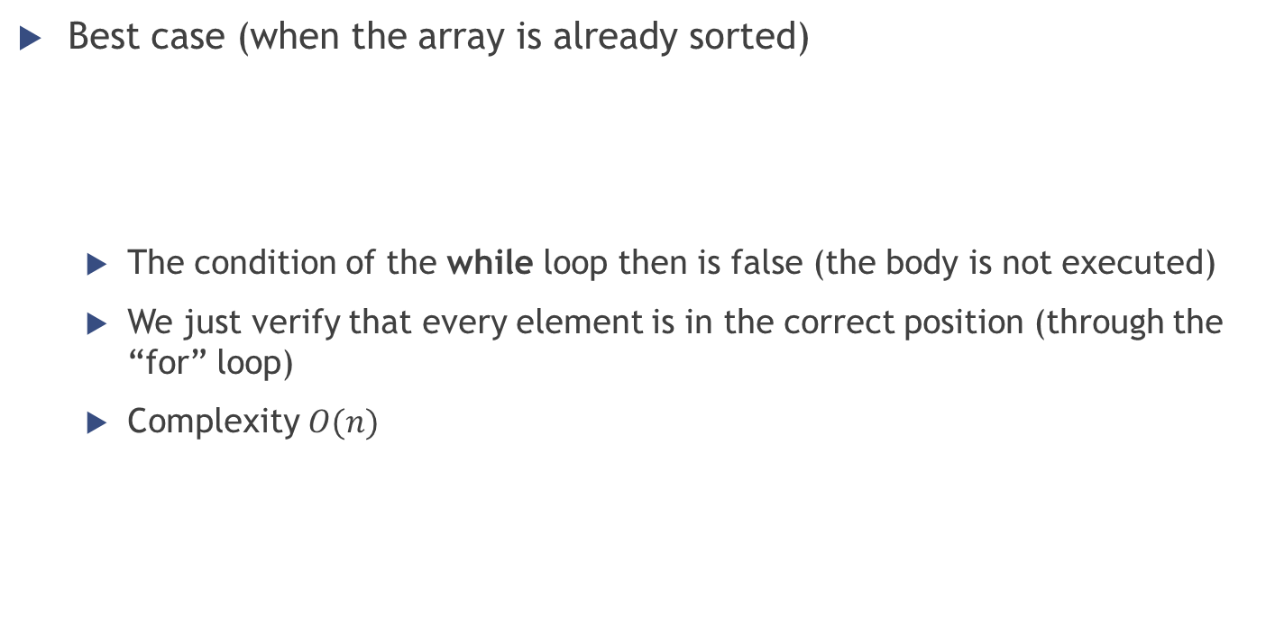
Insertion sort
FOR j = 2 to length(A)
key = A[j]
% put A[j] into the sorted sequence A[1..j-1]
i = j - 1
WHILE i > 0 and A[i] > key
A[i+1] = A[i]
i = i – 1
A[i+1] = key
Best case (when the array is already sorted)
The condition of the while loop then is false (the body is not executed)
We just verify that every element is in the correct position (through the “for” loop)
Complexity $O(n)$
2
4
5
7

Slide 22
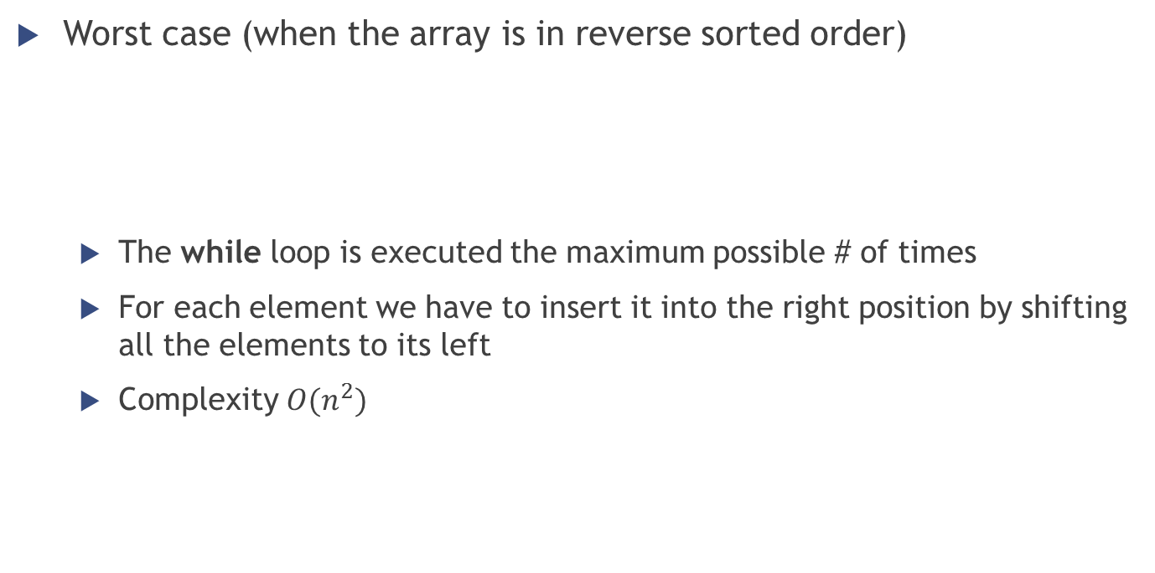
Insertion sort
FOR j = 2 to length(A)
key = A[j]
% put A[j] into the sorted sequence A[1..j-1]
i = j - 1
WHILE i > 0 and A[i] > key
A[i+1] = A[i]
i = i – 1
A[i+1] = key
Worst case (when the array is in reverse sorted order)
The while loop is executed the maximum possible # of times
For each element we have to insert it into the right position by shifting all the elements to its left
Complexity $O(n^{2})$
7
5
4
2

Slide 23

Insertion sort
Complexity analysis: summary
Best case → sequence already sorted
$$O(n)$$
Worst case → sequence in reverse sorted order
$$O\left(n^{2}\right)$$
3 | 5 | 6 | 9 | 11 | 15
15 | 11 | 9 | 6 | 5 | 3

Slide 24
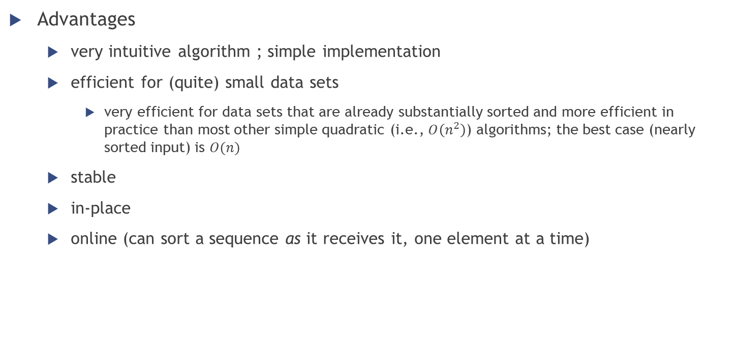
Insertion sort
Advantages
very intuitive algorithm ; simple implementation
efficient for (quite) small data sets
very efficient for data sets that are already substantially sorted and more efficient in practice than most other simple quadratic (i.e., $O\left(n^{2}\right)$) algorithms; the best case (nearly sorted input) is $O(n)$
stable
in-place
online (can sort a sequence as it receives it, one element at a time)

Slide 25
Bubble sort
A “similar” simple sorting algorithm is called Bubble Sort
It works by repeatedly swapping adjacent elements that are out of order
Pseudocode:
FOR i = 1 to length(A)
FOR j = length(A) downto i+1
if A[j] < A[j-1]
exchange A[j] with A[j-1]
What is the complexity of this algorithm?

Slide 26
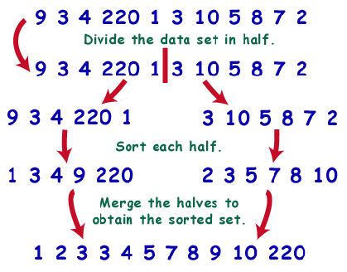
Merge sort

Slide 27
Merge sort
“Divide-and-conquer” approach
[DIVIDE] Break problem into smaller sub-problems
[CONQUER] Solve the sub-problems recursively
If the sub-problems are small enough just solve them straightforwardly
[COMBINE] Combine the solutions of the sub-problems

Slide 28
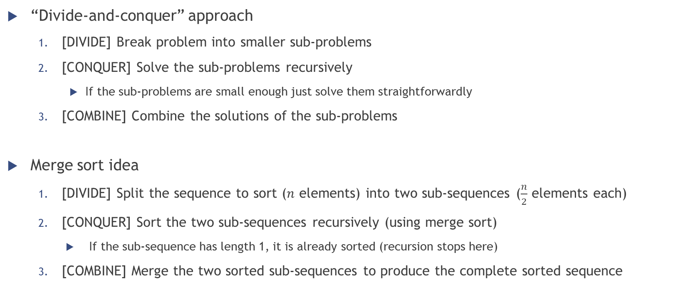
Merge sort
“Divide-and-conquer” approach
[DIVIDE] Break problem into smaller sub-problems
[CONQUER] Solve the sub-problems recursively
If the sub-problems are small enough just solve them straightforwardly
[COMBINE] Combine the solutions of the sub-problems
Merge sort idea
[DIVIDE] Split the sequence to sort ($n$ elements) into two sub-sequences ($\frac{n}{2}$ elements each)
[CONQUER] Sort the two sub-sequences recursively (using merge sort)
If the sub-sequence has length 1, it is already sorted (recursion stops here)
[COMBINE] Merge the two sorted sub-sequences to produce the complete sorted sequence

Slide 29
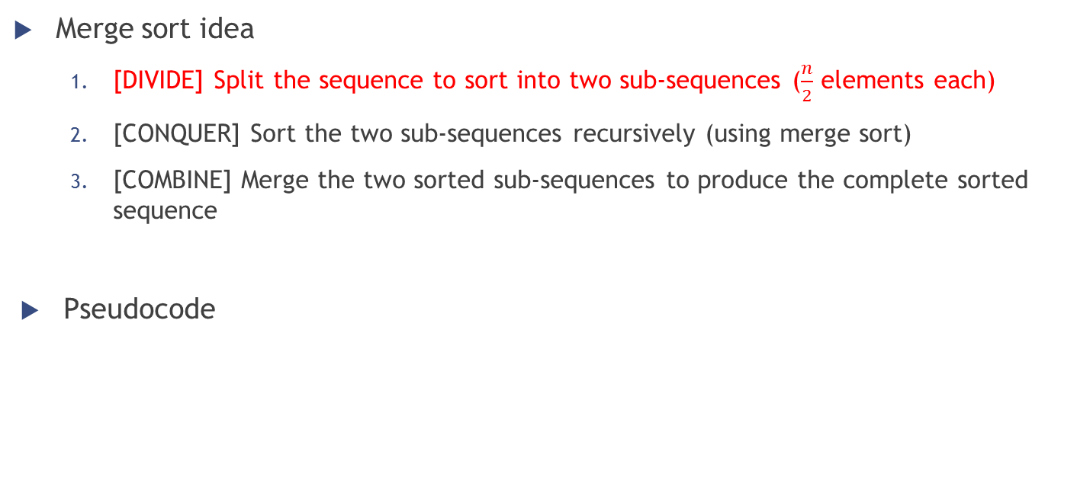
Merge sort
Merge sort idea
[DIVIDE] Split the sequence to sort into two sub-sequences ($\frac{n}{2}$ elements each)
[CONQUER] Sort the two sub-sequences recursively (using merge sort)
[COMBINE] Merge the two sorted sub-sequences to produce the complete sorted sequence
Pseudocode
MERGE-SORT(A,p,r)
if p < r
q = (p + r) / 2
MERGE-SORT(A,p,q)
MERGE-SORT(A,q+1,r)
MERGE(A,p,q,r)

Slide 30
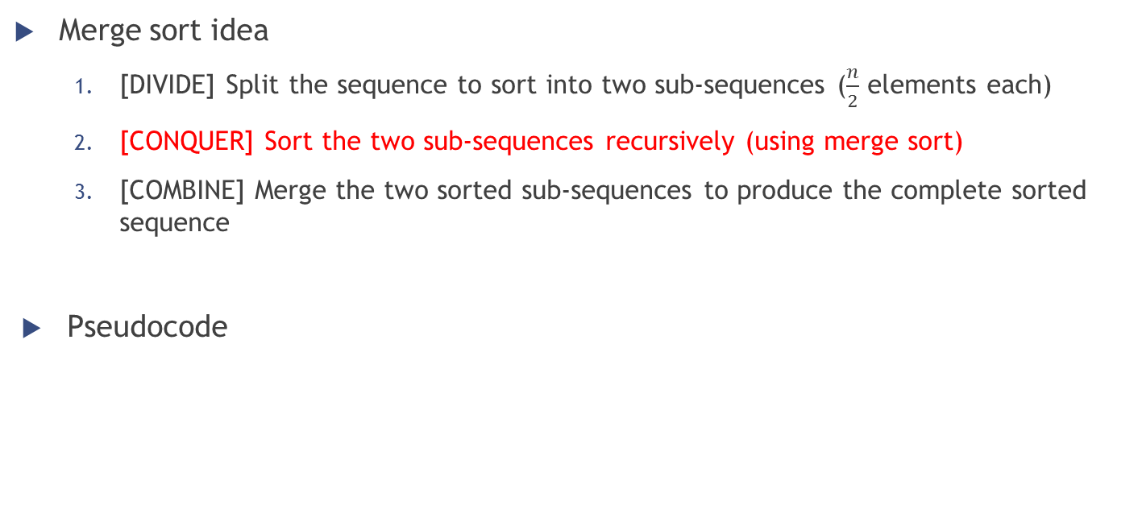
Merge sort
Merge sort idea
[DIVIDE] Split the sequence to sort into two sub-sequences ($\frac{n}{2}$ elements each)
[CONQUER] Sort the two sub-sequences recursively (using merge sort)
[COMBINE] Merge the two sorted sub-sequences to produce the complete sorted sequence
Pseudocode
MERGE-SORT(A,p,r)
if p < r
q = (p + r) / 2
MERGE-SORT(A,p,q)
MERGE-SORT(A,q+1,r)
MERGE(A,p,q,r)

Slide 31
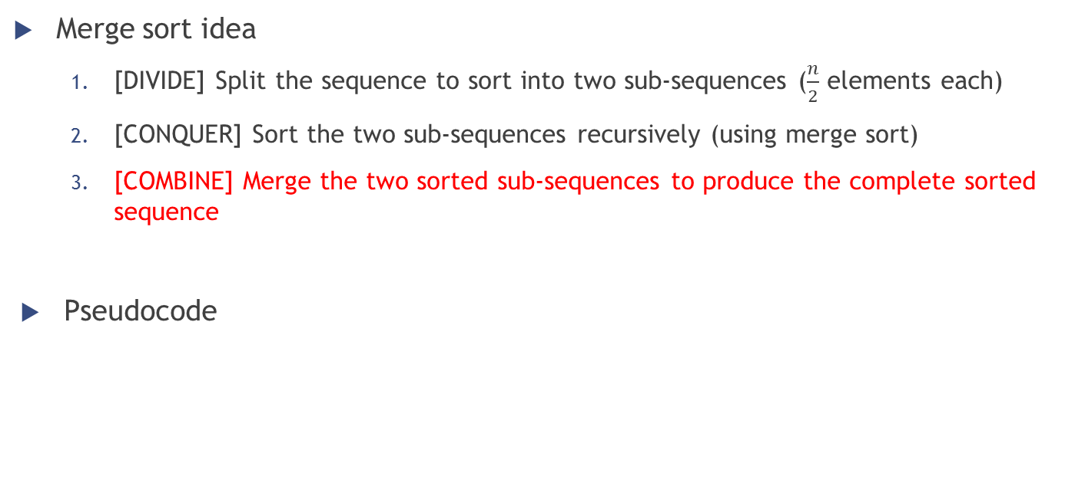
Merge sort
Merge sort idea
[DIVIDE] Split the sequence to sort into two sub-sequences ($\frac{n}{2}$ elements each)
[CONQUER] Sort the two sub-sequences recursively (using merge sort)
[COMBINE] Merge the two sorted sub-sequences to produce the complete sorted sequence
Pseudocode
MERGE-SORT(A,p,r)
if p < r
q = (p + r) / 2
MERGE-SORT(A,p,q)
MERGE-SORT(A,q+1,r)
MERGE(A,p,q,r)

Slide 32
Merge sort
How to combine two sorted sub-sequences into one?
Example
two sorted piles of cards (face-up; smallest card on top)
we want to merge them into a single sorted pile

Slide 33
Merge sort
How to combine two sorted sub-sequences into one?
Example
two sorted piles of cards (face-up; smallest card on top)
we want to merge them into a single sorted pile
Procedure
Choose the smallest of the two cards on top and remove it from its pile
Place this card into the output pile (face down)
Repeat the previous step until one of the two piles is empty
Take the remaining input pile and move it into the output one

Slide 34
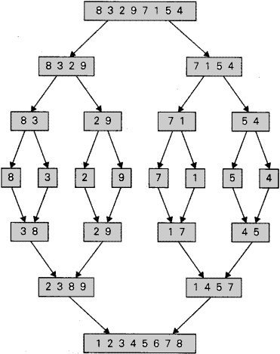
Merge sort
Example: merging the two sequences 2 3 8 9 and 1 4 5 7
Compare 2 and 1 → Put 1 into the output sequence
S1: 2 3 8 9; S2: 4 5 7; OUTPUT: 1
Compare 2 and 4 → Put 2 into the output sequence
S1: 3 8 9; S2: 4 5 7; OUTPUT: 1 2
Compare 3 and 4 → Put 3 into the output sequence
S1: 8 9; S2: 4 5 7; OUTPUT: 1 2 3
Compare 8 and 4 → Put 4 into the output sequence
S1: 8 9; S2: 5 7; OUTPUT: 1 2 3 4
…
/
9

Slide 35
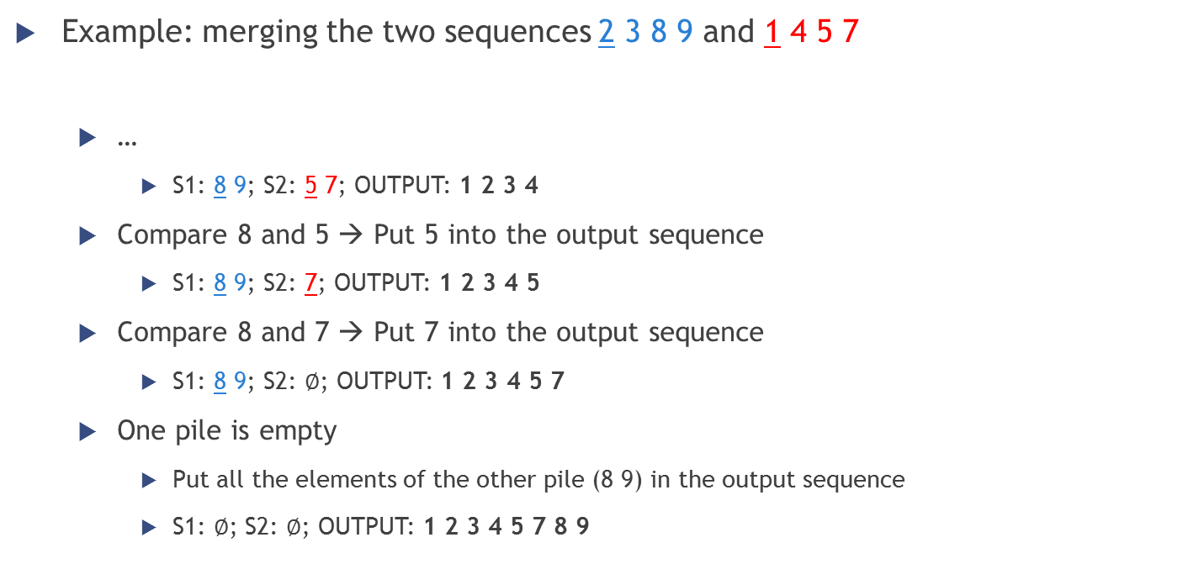
Merge sort
Example: merging the two sequences 2 3 8 9 and 1 4 5 7
…
S1: 8 9; S2: 5 7; OUTPUT: 1 2 3 4
Compare 8 and 5 → Put 5 into the output sequence
S1: 8 9; S2: 7; OUTPUT: 1 2 3 4 5
Compare 8 and 7 → Put 7 into the output sequence
S1: 8 9; S2: $∅$; OUTPUT: 1 2 3 4 5 7
One pile is empty
Put all the elements of the other pile (8 9) in the output sequence
S1: $∅$; S2: $∅$; OUTPUT: 1 2 3 4 5 7 8 9
/
9

Slide 36
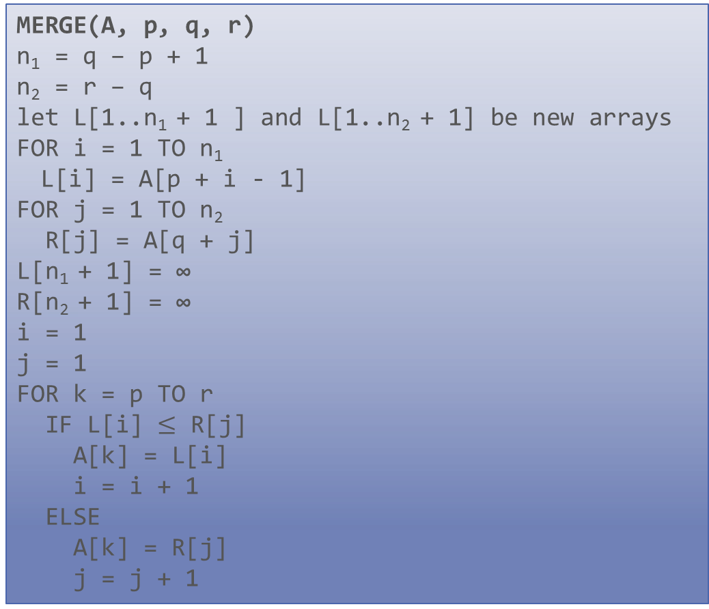
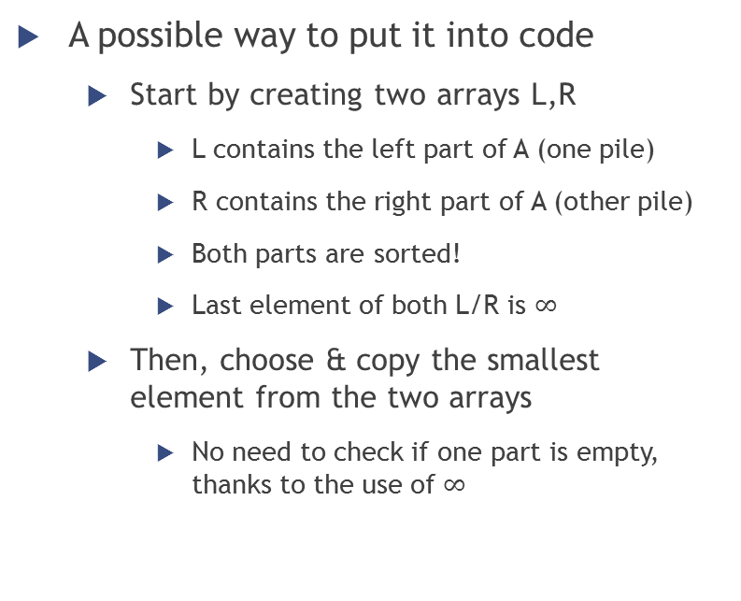
Merge sort
MERGE(A, p, q, r)
n₁ = q – p + 1
n₂ = r – q
let L[1..n₁ + 1 ] and L[1..n₂ + 1] be new arrays
FOR i = 1 TO n₁
L[i] = A[p + i - 1]
FOR j = 1 TO n₂
R[j] = A[q + j]
L[n₁ + 1] = ∞
R[n₂ + 1] = ∞
i = 1
j = 1
FOR k = p TO r
IF L[i] $≤$ R[j]
A[k] = L[i]
i = i + 1
ELSE
A[k] = R[j]
j = j + 1
A possible way to put it into code
Start by creating two arrays L,R
L contains the left part of A (one pile)
R contains the right part of A (other pile)
Both parts are sorted!
Last element of both L/R is $∞$
Then, choose & copy the smallest element from the two arrays
No need to check if one part is empty, thanks to the use of $∞$

Slide 37
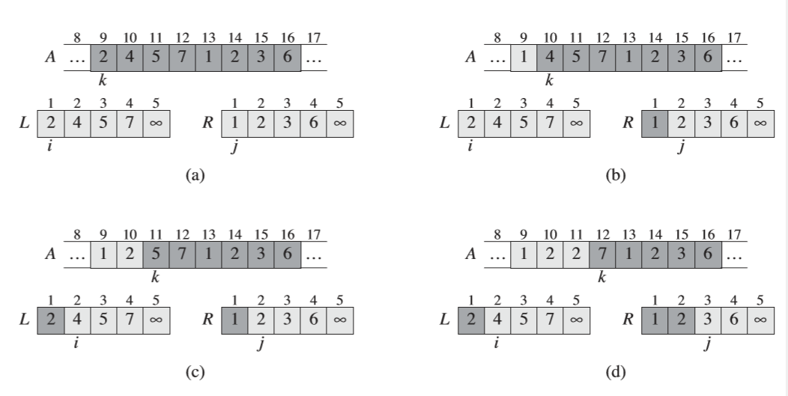
Merge sort

Slide 38
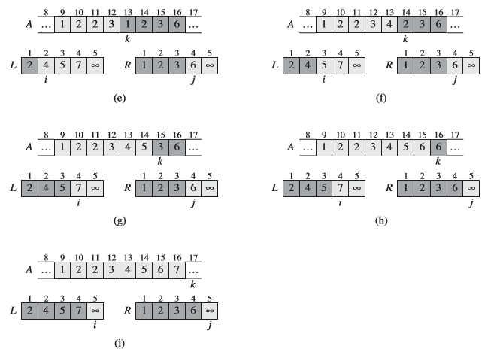
Merge sort

Slide 39
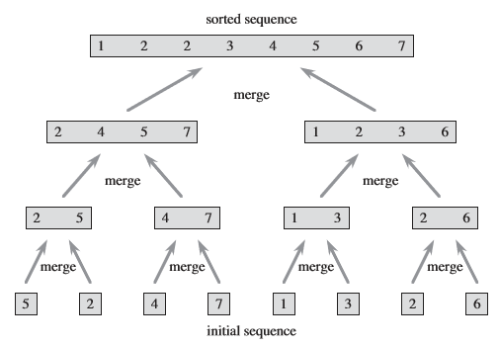
Merge sort

Slide 40
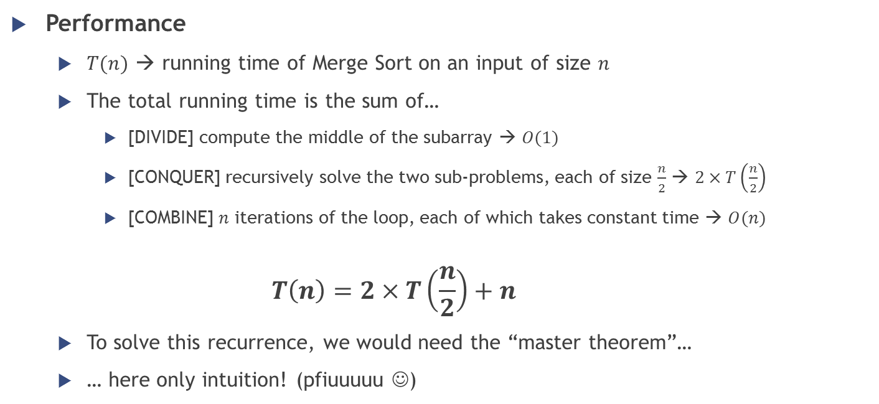
Merge sort
Performance
$T(n)$ → running time of Merge Sort on an input of size $n$
The total running time is the sum of…
[DIVIDE] compute the middle of the subarray → $O(1)$
[CONQUER] recursively solve the two sub-problems, each of size $\frac{n}{2}$ → $2×T\left(\frac{n}{2}\right)$
[COMBINE] $n$ iterations of the loop, each of which takes constant time → $O(n)$
$$T\left(n\right)=2×T\left(\frac{n}{2}\right)+n$$
To solve this recurrence, we would need the “master theorem”…
… here only intuition! (pfiuuuuu ☺)

Slide 41
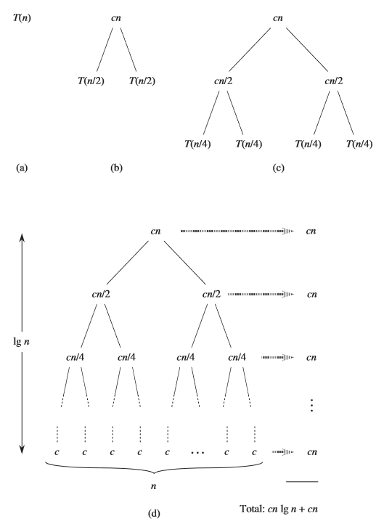
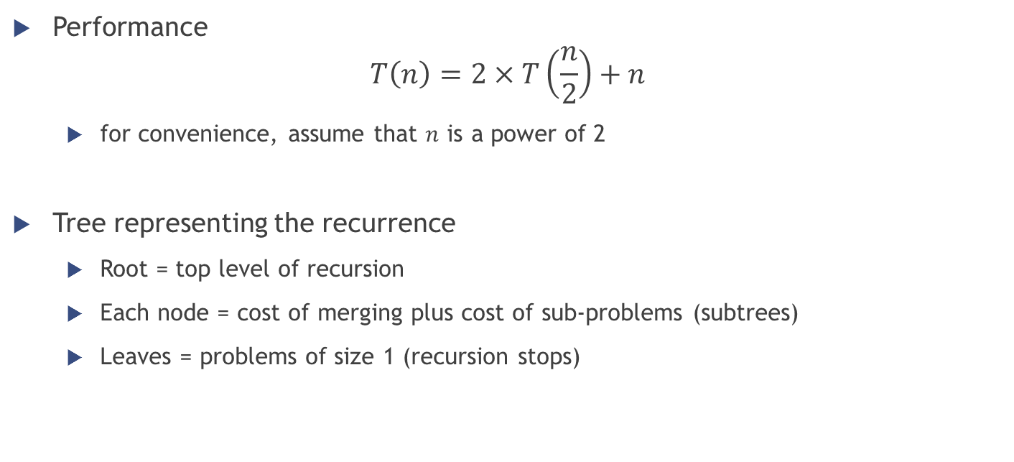
Merge sort
Performance
$$T\left(n\right)=2×T\left(\frac{n}{2}\right)+n$$
for convenience, assume that $n$ is a power of 2
Tree representing the recurrence
Root = top level of recursion
Each node = cost of merging plus cost of sub-problems (subtrees)
Leaves = problems of size 1 (recursion stops)

Slide 42
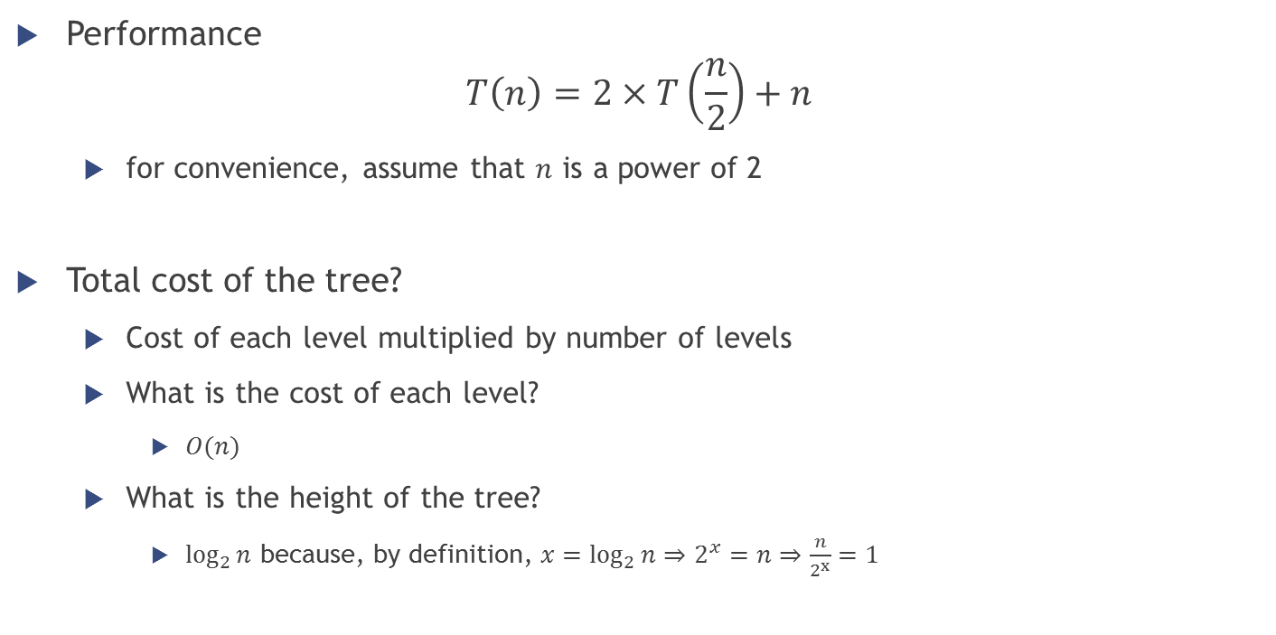
Merge sort
Performance
$$T\left(n\right)=2×T\left(\frac{n}{2}\right)+n$$
for convenience, assume that $n$ is a power of 2
Total cost of the tree?
Cost of each level multiplied by number of levels
What is the cost of each level?
$O(n)$
What is the height of the tree?
$\log_{2}{n}$ because, by definition, $x=\log_{2}{n}⇒2^{x}=n⇒\frac{n}{2^{x}}=1$

Slide 43
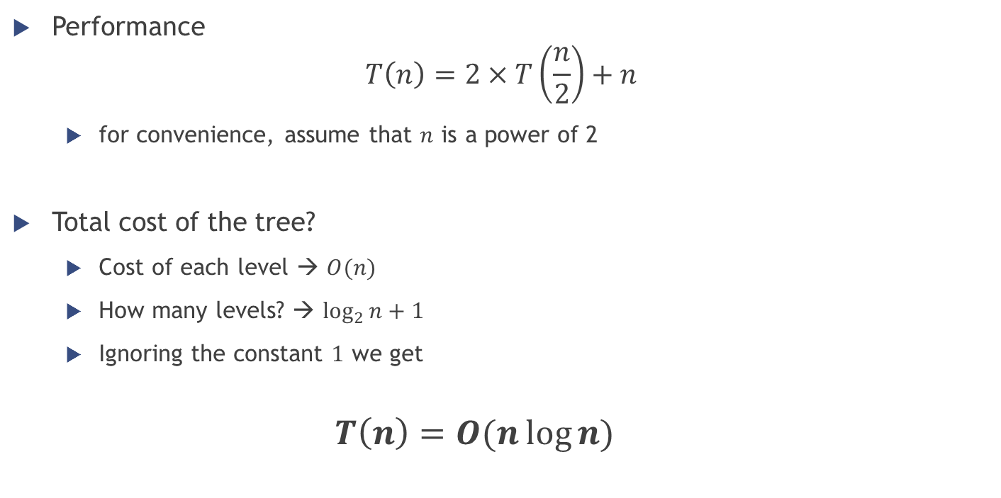
Merge sort
Performance
$$T\left(n\right)=2×T\left(\frac{n}{2}\right)+n$$
for convenience, assume that $n$ is a power of 2
Total cost of the tree?
Cost of each level → $O(n)$
How many levels? → $\log_{2}{n}+1$
Ignoring the constant $1$ we get
$$T\left(n\right)=O(n\log{n})$$

Slide 44
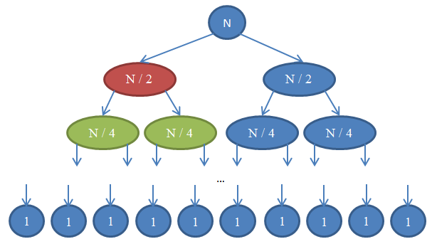
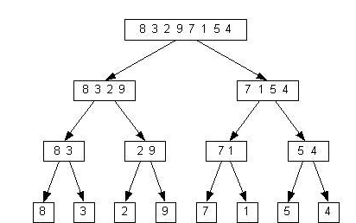
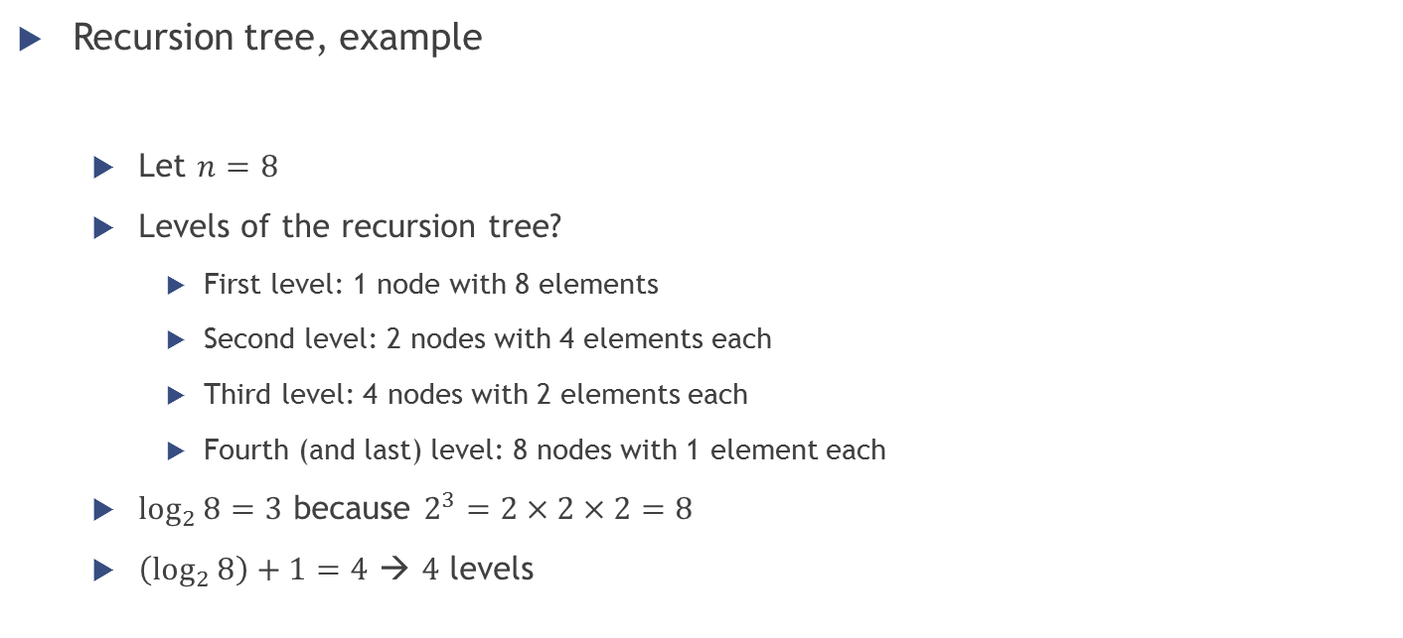
Merge sort
Recursion tree, example
Let $n=8$
Levels of the recursion tree?
First level: 1 node with 8 elements
Second level: 2 nodes with 4 elements each
Third level: 4 nodes with 2 elements each
Fourth (and last) level: 8 nodes with 1 element each
$\log_{2}{8}=3$ because $2^{3}=2×2×2=8$
$\left(\log_{2}{8}\right)+1=4$ → $4$ levels

Slide 45
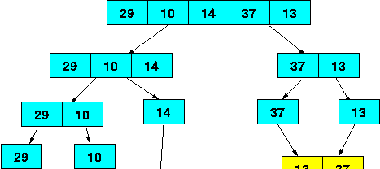
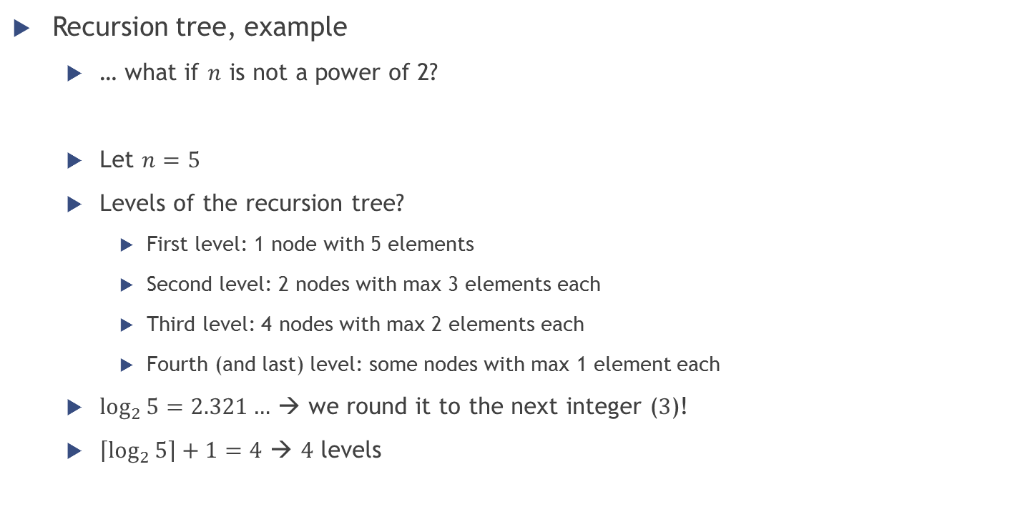
Merge sort
Recursion tree, example
… what if $n$ is not a power of 2?
Let $n=5$
Levels of the recursion tree?
First level: 1 node with 5 elements
Second level: 2 nodes with max 3 elements each
Third level: 4 nodes with max 2 elements each
Fourth (and last) level: some nodes with max 1 element each
$\log_{2}{5}{=2.321…}$ → we round it to the next integer ($3$)!
$\left\lceil \log_{2}{5}\right\rceil +1=4$ → $4$ levels

Slide 46


Homework
Study the slides
Multiple choice questions on GrandeOmega
Implement the two sorting algorithms (Insertion sort and Merge sort)
Facultative: try to make it generic with respect to the type of the elements being sorted (using a comparator)
Implement also Bubble sort
Download the practical assignment from N@tschool and try it
The first exercise in there is about merge sort
… See you next week ☺

